Slide 1


Vehicle Intersection control
Alex Jackson
Jean Lucas Ferreira
Justin Kapinski
Mathew Hobers
Radhika Sharma
Zachary Bazen
Group 6
VIC -1
Intersection Management for autonomous
vehicles

Slide 2
Possible Presentation TIME LINE (DELETE THIS SLIDE)
Total presentation is 20 minutes (Including setup )
1 or 2 minutes of set up
We should have the skype call pre connect prior to presentation if we can
7 -9 min talking and explaining on slides
Include a minute or 2 for backup slides and pictures
5 minutes of demo
~ 16 minutes now of presentation (allows for unexpected longer demo)
2 – 3 minutes for questions
There’s 2 screens (smaller screen for live demo)
Smaller screen for live demo
Larger screen for present
Participation
2 at marc? (keep things moving fast)
4 at presentation in big room

Slide 3
Outline

Slide 4
What VIC Does

Slide 5
How it works

Slide 6
Innovative aspects

Slide 7
Cost

Slide 8
Technical details

Slide 9
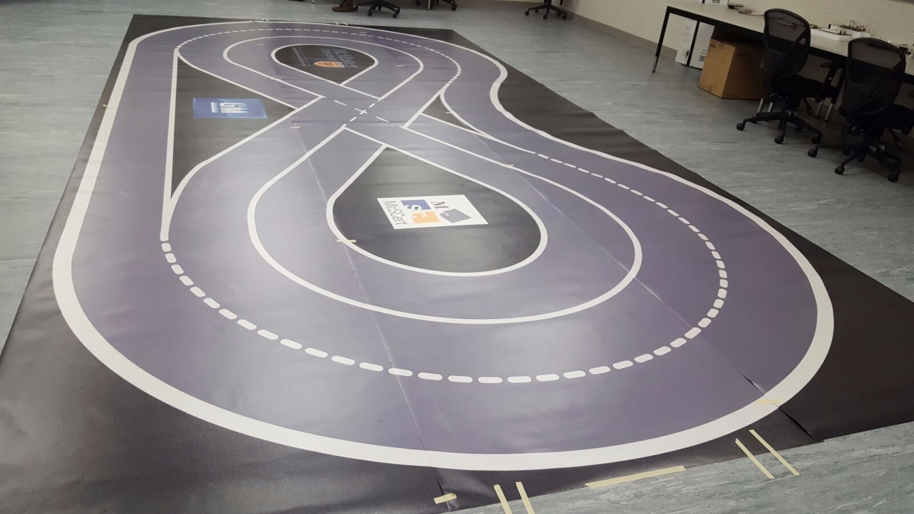
Overview – Continued

Slide 10
Live Demo
Group 6
VIC -1

Slide 11
Additional Demonstrations

Slide 12
Questions
Group 6
VIC -1

